Slide 1

Forecasting Students’ Academic Performance Using
Support Vector Machine
Under the Supervision of
Mrs. N.Gowri Sreelakshmi , Asst. Prof.
Presented By: Batch No: 10
19551A0529 – J.SAI MUKESH
19551A0581 – G.SRINIVASARAO
19551A0541 – M.SAI YOUZEN
19551A05B2 – M.KARTHIK
19551A05A0 – K.NITHIN
Project Presentation: Final Review
Date of Review: 21/02/2022
Branch: CSE, IV B.Tech II Sem

Slide 2
PROJECT AGENDA
Abstract
Existing Model
Proposed Model
Working of the proposed model
Performance Evaluation
Conclusion
References

Slide 3
Abstract
In higher education institutions, forecasting student success is an important goal. Academic advancement and personality traits related to learning activities are among the variables that might affect academic performance. The primary constituents of the training dataset are common traits of students such as age, gender, study habits, class attendance, and family size. This study investigated the effectiveness of various supervised algorithms in machine learning for predicting student grades. The Support Vector Machine algorithm is a reliable and popular technique, but it's rarely used for predictions. The study used Support Vector Machines to predict students' grades and compared the results with other methods.

Slide 4
Existing Model
The existing model for predicting academic performance includes the widely used K-Nearest Neighbors (KNN) and Logistic Regression machine learning algorithms. KNN relies on the past academic performance of similar students to make predictions, while logistic regression predicts whether a student will pass or fail a course based on their past academic performance. However, KNN can be sensitive to the choice of K and computationally expensive, while logistic regression assumes a linear relationship and may suffer from overfitting. Despite these potential drawbacks, both methods can be effective for forecasting student academic performance with careful application and consideration for the dataset and problem at hand.

Slide 5
Proposed Model
In this proposed model, we utilized three well-known machine learning algorithms, namely logistic regression, K-Nearest Neighbors (KNN), and Support Vector Machine (SVM) to predict student performance. We attempted to enhance the accuracy of the existing logistic regression and KNN models by conducting hyperparameter tuning. However, even after hyperparameter tuning, the accuracy of these models remained lower than that of the SVM model. We also compared different SVM kernels, including linear, polynomial, and kernel methods, and found that the linear kernel provided the best results in terms of accuracy.
The model's performance is evaluated using various quality metrics, including ROC curve, f1 score, confusion matrix, and root mean square error, in addition to accuracy comparisons.

Slide 6
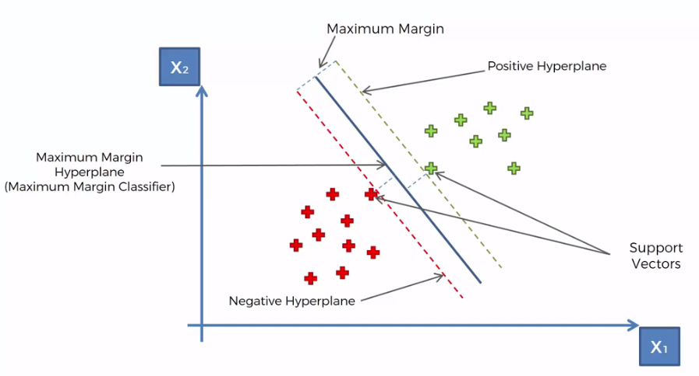
Methodology
SVM
  Support Vector Machine (SVM), is familiar set of Supervised Learning techniques used for classification and regression problems and outlier detection. Support Vector Machine is used to resolve both linear and non-linear. The idea of SVM is so simple, it creates or hyperplane which separates data into classes. In high-dimensional spaces, SVM is more effective. transforms non-linearly separable data from lower dimensions to higher dimensions to facilitate linear classification by using kernel.

Slide 7
Working of proposed model
Import Dataset
Data Preprocessing & Visualization
Model Implementation & Hyperparameter tuning
Comparison of models using quality metrics
Selection of best model based on quality metrics

Slide 8
Performance Evaluation
The proposed model for this project, including Logistic Regression, K-Nearest Neighbors (KNN), and Support Vector Machine (SVM), were evaluated using various quality metrics to determine their effectiveness. The following metrics were used to evaluate the models:
F1 score: The F1 score is a metric that combines precision and recall to provide a measure of a model's accuracy.
ROC curve: The ROC (Receiver Operating Characteristic) curve is a graphical representation of a model's ability to distinguish between positive and negative classes.
Confusion matrix: A confusion matrix is a table that summarizes the performance of a classification algorithm.
Accuracy: Accuracy is the most commonly used metric for evaluating classification models. It is the ratio of the number of correct predictions to the total number of predictions.
Root Mean Square Error (RMSE): RMSE is a measure of the difference between the predicted and actual values. It provides a measure of how well the model is able to fit the data.

Slide 9
Conclusion
In conclusion, the evaluation of the three machine learning models for forecasting students' academic performance showed that the SVM model outperformed the logistic regression and KNN models in terms of multiple quality metrics, including F1 score, accuracy, and ROC. The SVM model had the lowest RMSE and highest ROC scores, indicating that it was the most accurate in predicting students' academic performance. The results highlight the importance of considering multiple quality metrics when evaluating model performance. By utilizing SVM models, it is possible to make informed decisions and take targeted actions to improve students' outcomes. Overall, the findings of this project provide valuable insights into the factors that impact students' exam scores and have the potential to inform future educational policies and practices.

Slide 10
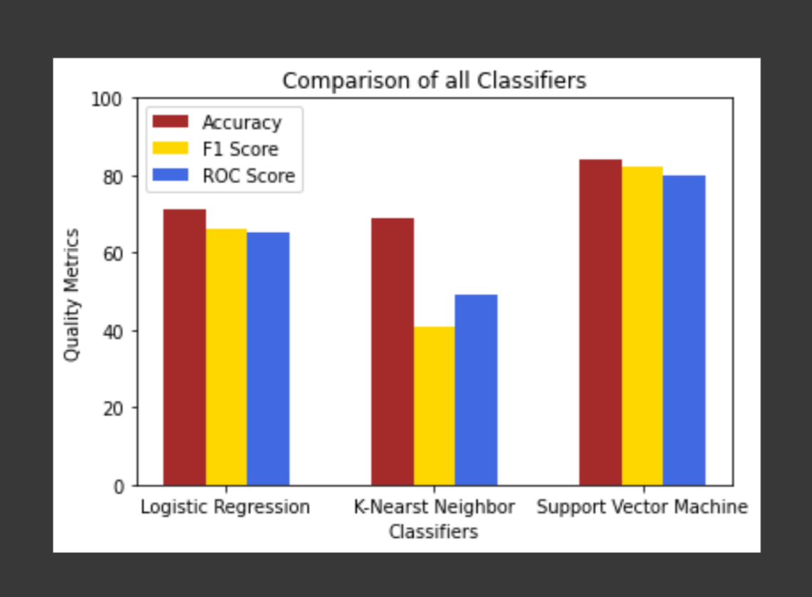
.

Slide 11
References
"W. Tomohisa, M. Dawodi, N. Ahmadi, and M. Mohammadi (2019). A comparison of supervised learning algorithms for predicting student performance. The International Conference on Artificial Intelligence in Information and Communication (ICAIIC) will be held in 2019. (pp. 124-127). IEEE, doi:10.1109/ICAIIC.2019.8669085.
M. Ayan, M. Garca (2008). academic performance of university students predicted using linear and logistic models. 11(1), 275-288 The Spanish Journal of Psychology. https://doi.org/10.1017/S1138741600004315
Iqbal, Z., Qadir, J., and Qayyum, A., along with Latif, S. (2019). An empirical investigation of early student grade prediction. The 2019 Second International Conference on Advances in Computational Sciences (ICACS) will be held at (pp. 1-7). The IEEE. https://doi.org/10.23919/ICACS.2019.8689136
N. M. Rusli, Z. Ibrahim, and R. M. Janor (2008). Comparison of neuro-fuzzy, logistic regression, and artificial neural networks for predicting students' academic success. International Information Technology Symposium in 2008 (pp. 1-6). IEEE, doi:10.1109/ITSIM.2008.4631535.
A systematic review of the literature on machine learning techniques for predicting student performance. Science and education 2021; 11(9):552 by Albreiki B, Zaki N, and Alashwal H. https://doi.org/10.3390/educsci11090552

Slide 12
Thank You

